Slide 1
Learning Indirect Memory Access Patterns of GPU Applications
Nafis Mustakin Sakshar Chakravarty

Slide 2
Outline
Motivation & Background
Related Works
Objective
Data Visualization
Model Architecture
Indirect Access detection
Indirect Access prediction
Evaluation
Conclusion and Future Work

Slide 3
Outline
Motivation & Background
Related Works
Objective
Data Visualization
Model Architecture
Indirect Access detection
Indirect Access prediction
Evaluation
Conclusion and Future Work

Slide 4
Motivation & Background
Why learn Indirect Access Patterns of GPU Applications?
We want to exploit the data-level parallelism between kernels
But how to tell if kernels are independent?
Wireframe[1]: forms dependency graphs
Can only capture compile time information
Indirect accesses can only be resolved in runtime

Slide 5
Motivation & Background
Indirect Accesses types:
Regular: Address translations from a table of the type B[A[0]]
Easier to predict
Irregular: Common in graph traversal algorithms (e.g. BFS)
Harder to predict
NN models?

Slide 6
Related Work
Memory access patterns have been analyzed for adding new instructions by Crago et. al. [2]
Hashemi et. al. [3] have shown clustering + LSTM based models can work very well for predicting memory accesses in CPU workloads.
No such work done for GPU applications

Slide 7
Objective
Learn indirect memory access patterns of GPU workloads using -
Clustering to isolate indirect accesses
RNN models to predict indirect access patterns
Use learned patterns to check for kernel dependencies

Slide 8
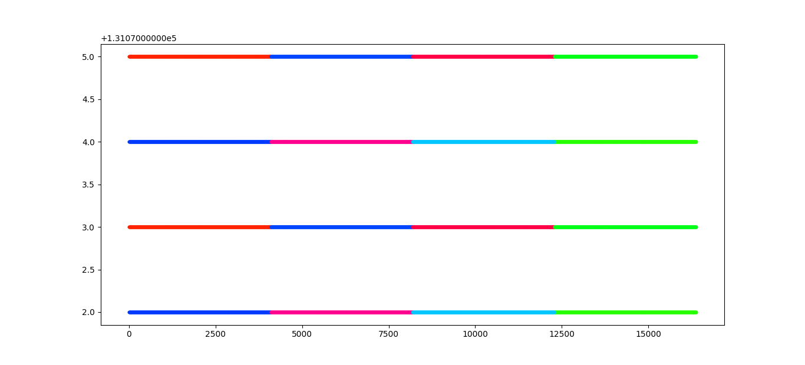
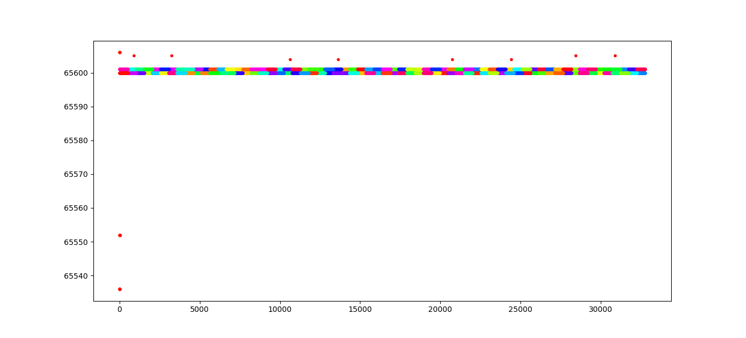
Data Visualization
Figure 1a: Vector Addition
Figure 1b: BFS

Slide 9
Outline
Motivation & Background
Related Works
Objective
Data Visualization
Model Architecture
Indirect Access detection
Indirect Access prediction
Evaluation
Conclusion and Future Work

Slide 10
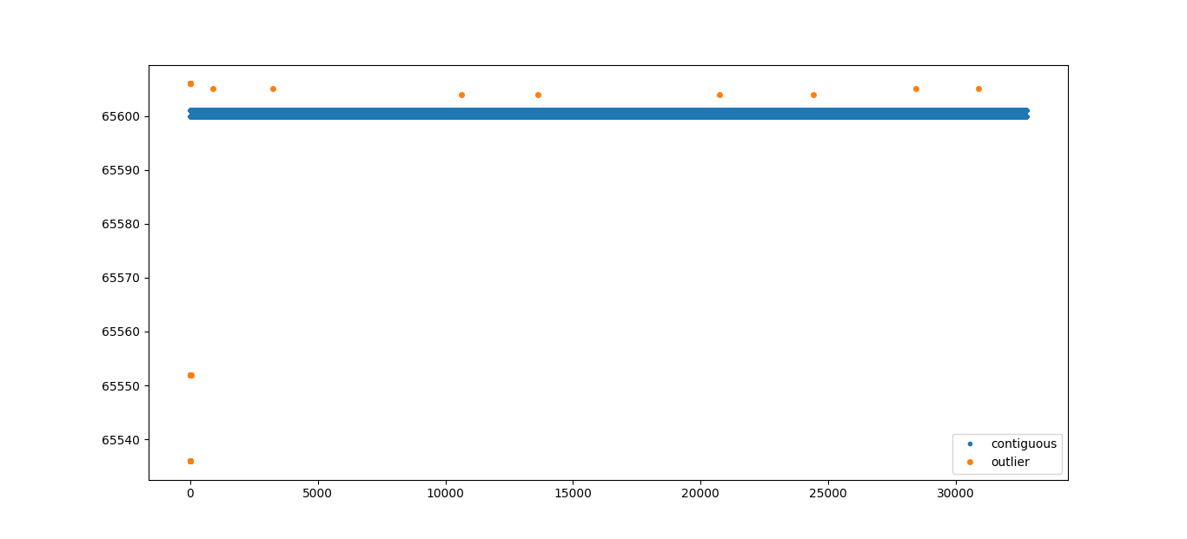
Indirect Access Detection
Figure 2: Outlier Addresses

Slide 11
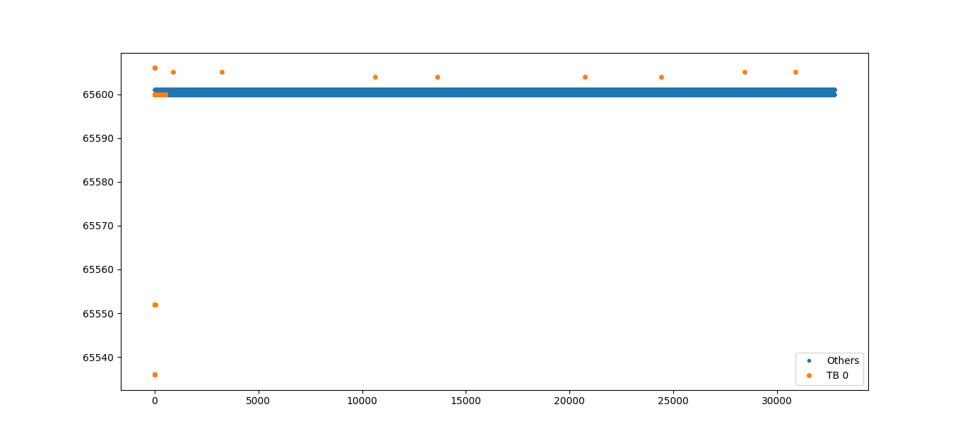
Addresses accessed by TB 0
Figure 3: TB 0 addresses

Slide 12
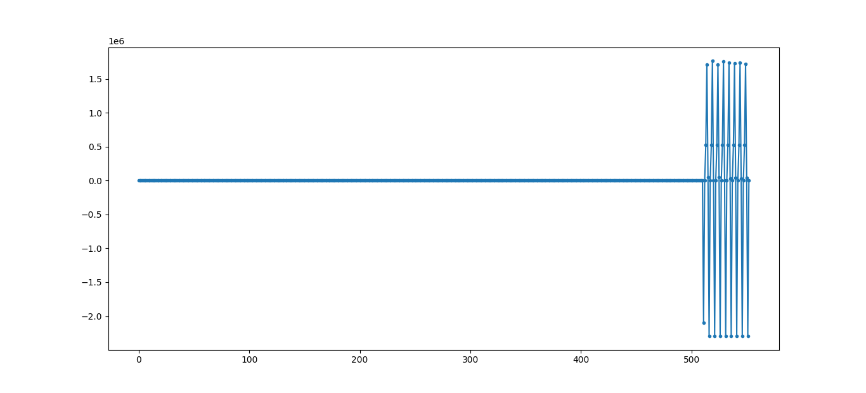
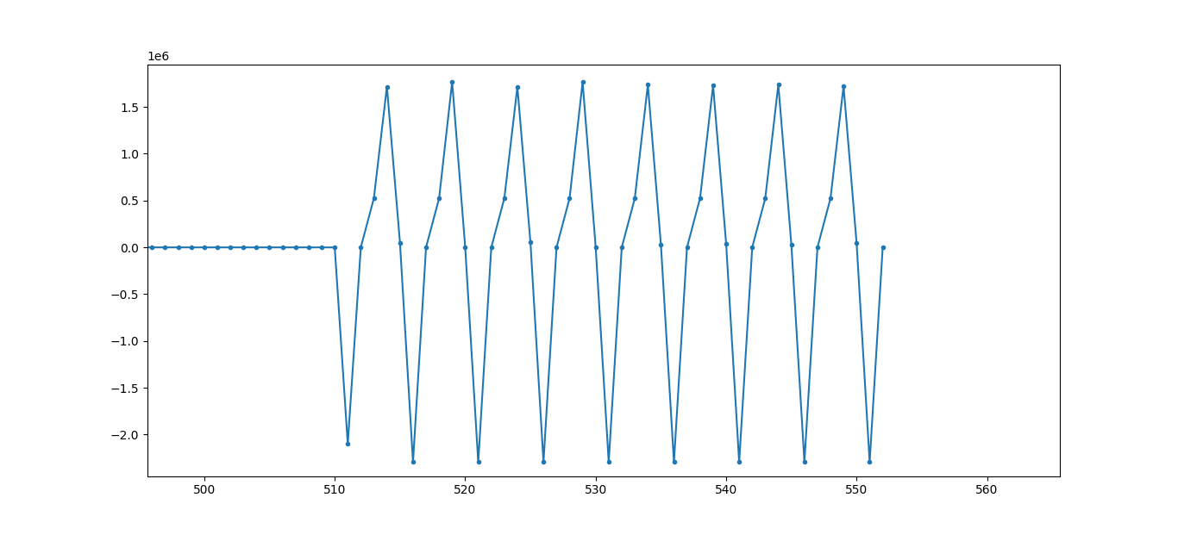
Deltas of TB 0
Figure 4a: TB 0 deltas
Figure 4b: TB 0 indirect access deltas

Slide 13
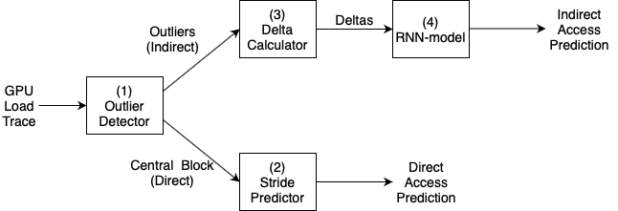
Model Architecture
Choice of
LSTM vs SimpleRNN
Figure 5: Model Architecture

Slide 14
Outline
Motivation & Background
Related Works
Objective
Data Visualization
Model Architecture
Indirect Access detection
Indirect Access prediction
Evaluation
Conclusion and Future Work

Slide 15
Evaluation metrics
Hashemi et. al. uses Precision-at-10 and Recall-at-10
We don’t limit our vocabulary so our model is not that specific.
Use RMSE instead

Slide 16
RNN RMSE
On Training Data
Lookback\Block | 128 | 256 | 512
4 | 436748.12 | 493503.58 | 548773.77
8 | 49054.5 | 50828.75 | 34289.67
12 | 30842.73 | 64119.81 | 52505.42
On Test Data
Lookback\Block | 128 | 256 | 512
4 | 301290.21 | 423956.36 | 406741.53
8 | 41620.78 | 43696.74 | 28968.93
12 | 22818.1 | 67755.01 | 49233.47

Slide 17
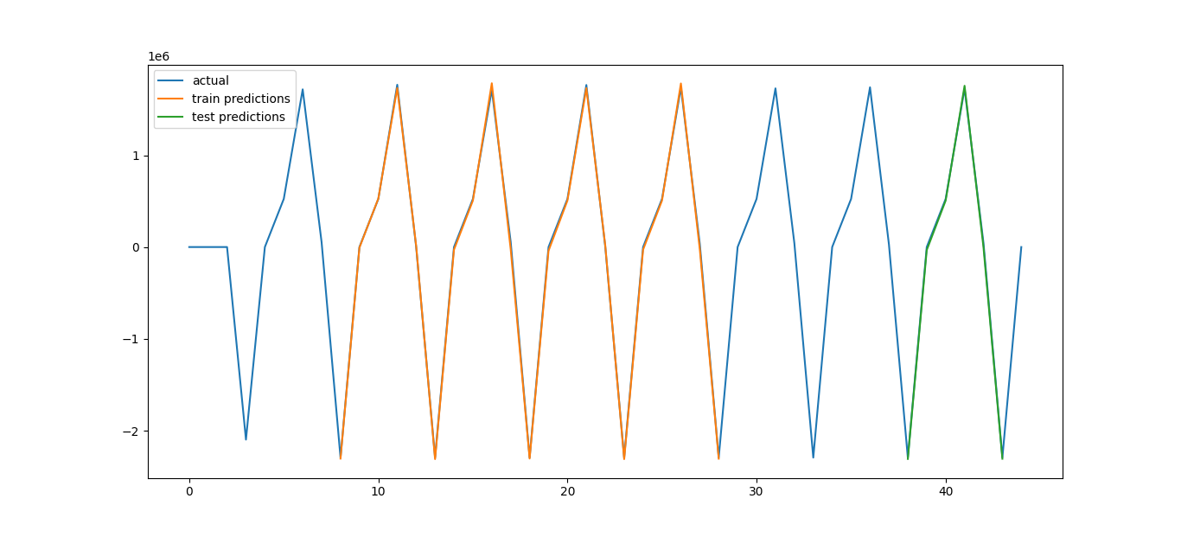
Prediction plot for simple RNN
Figure 6: Performance of 512 block, 8 lookback Simple RNN

Slide 18
LSTM RMSE
On Training Data
Lookback\Block | 128 | 200 | 220 | 512
3 | 350968.9 | 346503.4 | 299282 | 289597
8 | 37256.3 | 59766.6 | 41899.5 | 32688.9
10 | 56655.3 | 42484 | 38053.4 | 50439.3
On Test Data
Lookback\Block | 128 | 200 | 220 | 512
3 | 158036.5 | 200604.3 | 61028.9 | 69049.8
8 | 23048.8 | 54652.5 | 29783.4 | 21352.7
10 | 37845.6 | 38706.6 | 20984.4 | 34171.6

Slide 19
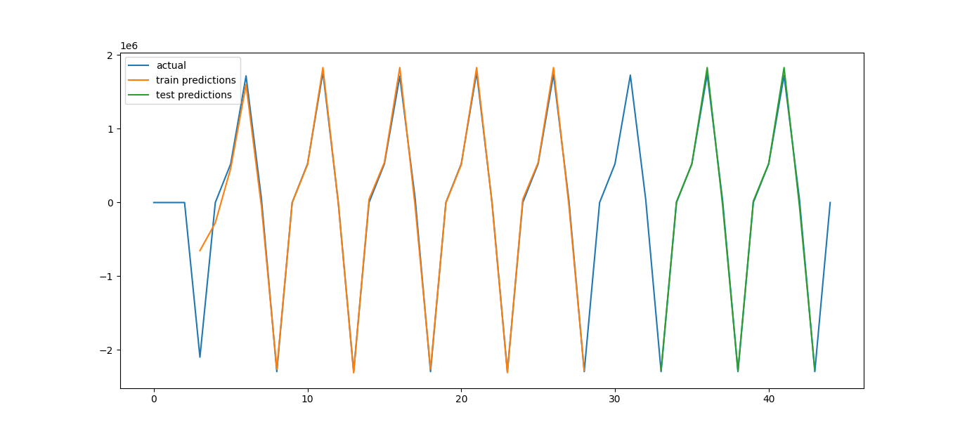
Prediction plot for LSTM
Figure 7: Performance of 220 block, 3 lookback LSTM

Slide 20
Conclusion
High RMSE? No problem
We can tolerate some error, we are looking for a range of address to check kernel dependency
Small dataset, complex model
Is it memorizing?

Slide 21
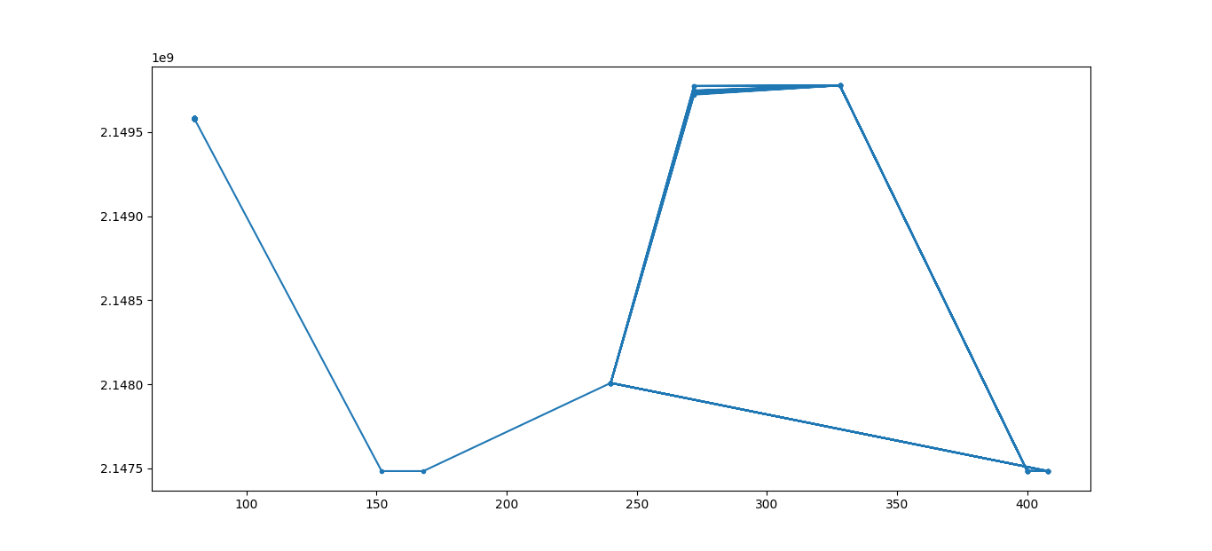
Future Work
Test for more data
If it doesn’t work, use PC as additional context
Figure 8: TB 0 PC vs Address

Slide 22
References
[1] AmirAli Abdolrashidi, Devashree Tripathy, Mehmet Esat Belviranli, Laxmi Narayan Bhuyan, and Daniel Wong. 2017. Wireframe: supporting data-dependent parallelism through dependency graph execution in GPUs. In Proceedings of the 50th Annual IEEE/ACM International Symposium on Microarchitecture (MICRO-50 '17). Association for Computing Machinery, New York, NY, USA, 600–611. DOI:https://doi.org/10.1145/3123939.3123976
[2] Neal C. Crago, Mark Stephenson, and Stephen W. Keckler. 2018. Exposing Memory Access Patterns to Improve Instruction and Memory Efficiency in GPUs. ACM Trans. Archit. Code Optim. 15, 4, Article 45 (January 2019), 23 pages. DOI:https://doi.org/10.1145/3280851
[3] Milad Hashemi, Kevin Swersky, Jamie Smith, Grant Ayers, Heiner Litz, Jichuan Chang, Christos Kozyrakis, Parthasarathy Ranganathan. 2018. Learning Memory Access Patterns. Proceedings of the 35th International Conference on Machine Learning, PMLR 80:1919-1928, 2018.

Slide 23
Thank you for listening!

